Slide 1
Long-writing Tasks: Writing a News Report

Slide 2
Samples from 2010
Here are some samples of student work with grades from the 2010 OSSLT test.
Please take some time to review the answers and the commentary on why each student scored a particular mark.

Slide 3
Writing a News Report
Task: Write a news report on the next page based on the headline and picture below.
• You will have to make up the facts and information to answer some or all of the following questions: Who? What? Where? When? Why? How?
• You must relate your newspaper report to both the headline and the picture.
Purpose and Audience: to report on an event for the readers of a newspaper
Length: The lined space provided for your written work indicates the approximate length of the writing expected.

Slide 4
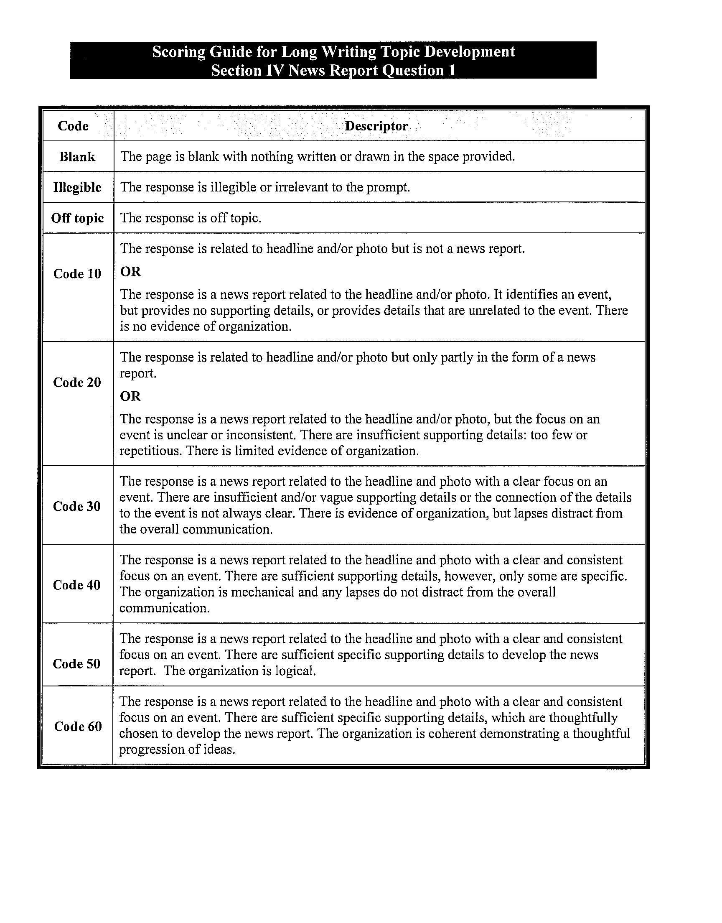

Slide 5
Storm Shuts Down Region

Slide 6
(Very Poor Answer)

Slide 7
(Poor Answer)

Slide 8
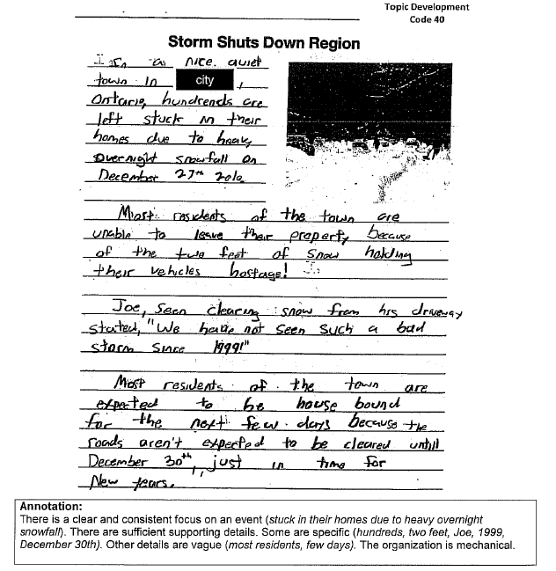
(Better Answer)

Slide 9
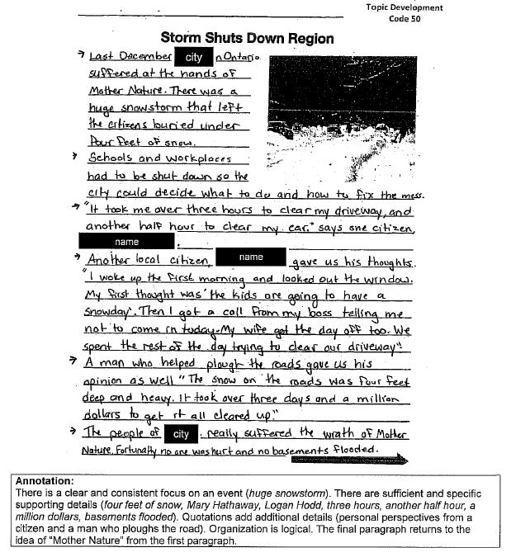
(Best Answer)

Slide 10
Writing a News Report
The Inverted Pyramid
Most news stories are written in the inverted pyramid style. This means all the important information — most of the 5 W’s — can be found in the lead. Information and quotes are added according to their importance. The least important information can be found at the bottom of the story, or pyramid.
Headline
Lead
Important Facts
Important Facts
Facts
Facts
Facts

Slide 11
Strategies for a News Report
Look closely at the picture and the headline. Think of an event that relates to them.
Create interesting “facts” answering the questions: who, what , where, when, why and how
Use quotations to make the report more interesting.
Write in short paragraphs.
Be sure your news report reflects the picture and headline or it will be scored much lower.
Write your report in the third person (i.e. “he said,” not “I said”).

Slide 12
Class Task – Writing a News Report
Write a news report based on the following headline and picture.
You will have to make up the facts and information answering some or all of the following questions: Who? What? Where? When? Why? How?
Purpose and Audience: to report on an event for the readers of a newspaper
Length: Approximately 1 – 2 pages.

Slide 13
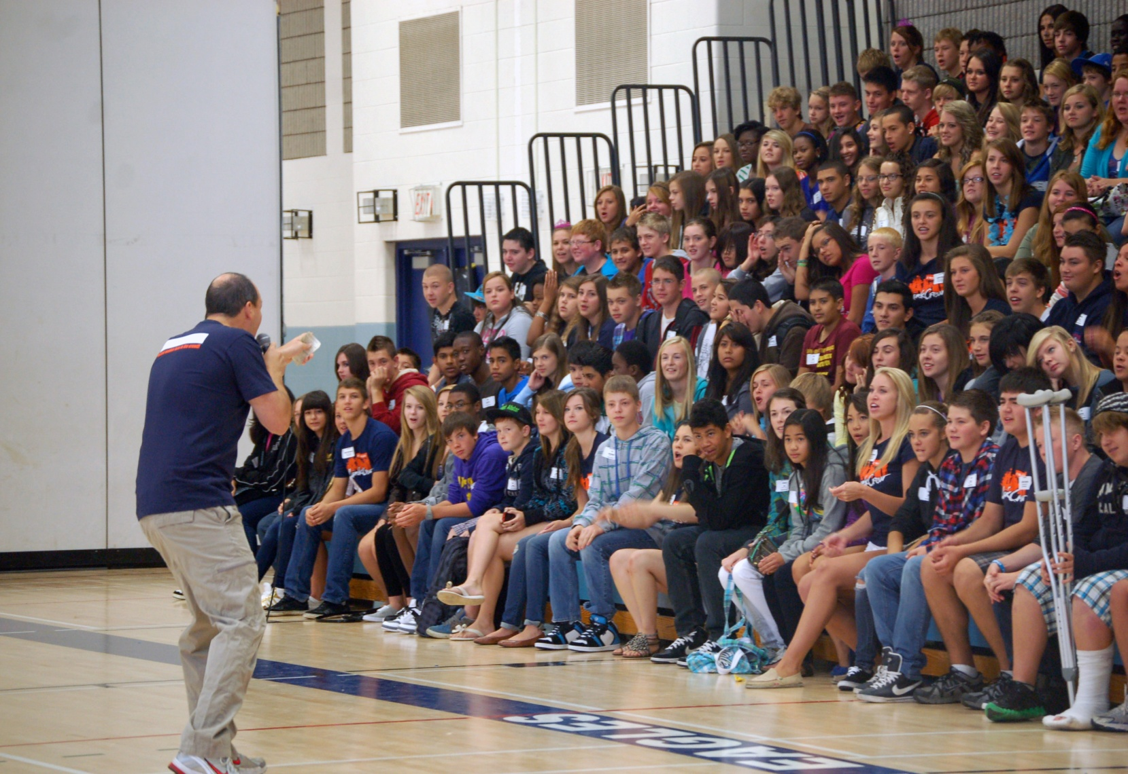
Teacher Inspires Youth

