Slide 1
Love?
Real or not?

Slide 2
What is Love?
Robert Sternberg, an American psychologist, interviewed hundreds of men and women who said they were in love and analyzed their responses to determine the qualities of romantic love and to distinguish between romantic love and friendship
Sternberg determined that romantic love has 3 “faces”: passion, intimacy and commitment

Slide 3
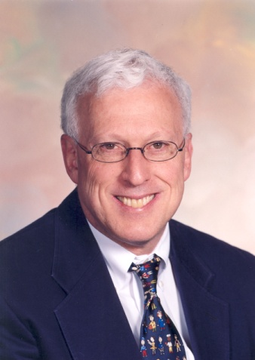
Robert Sternberg
Passion, a strong feeling of sexual desire for another, develops the most quickly of the three. This probably results from a biological drive to reproduce.
Ex. Romeo and Juliet
The intense friendship of intimacy develops more slowly, as each individual shares his or her experiences, thoughts, and feeling with another and becomes willing to meet the other’s psychological needs

Slide 4
Robert Sternberg
Commitment to maintaining the relationship grows as the rewards of being in this relationship instead of in others become evident and individuals accept reciprocal roles and mutual interdependence
Sternberg chose to represent love as a triangle so that relationships with various proportions of passion, intimacy and commitment could be depicted by varying the length of the sides

Slide 5
Sternberg’s Love Triangle
COMMITMENT
INTIMACY
PASSION

Slide 6
Sternberg’s Love Triangle
Love relationships based on intimacy require the individuals to fully appreciate each other’s uniqueness and separateness
A companionate relationship requires an understanding of what one has to offer another and what one needs from another in return

