Slide 1
Films et musique des 1920

Slide 2
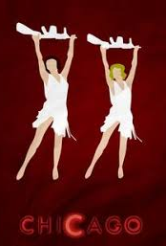
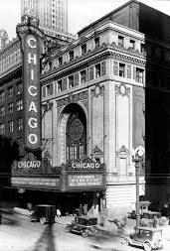
Chicago Nowadays Hot Honey Rag
https://www.youtube.com/watch?v=rHiUwgdXIj8

Slide 3
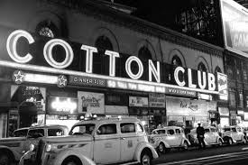
Duke Ellington chez le “Cotton Club”
https://www.youtube.com/watch?v=HcY40rJLbDU

Slide 4
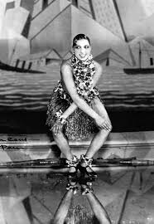
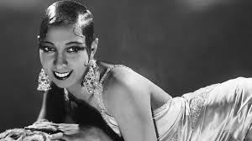
Josephine Baker danseuse, chanteuse, comédienne
https://www.youtube.com/watch?v=jEH6eDpjgRw
https://www.youtube.com/watch?v=NBGXsQfGY4M

Slide 5
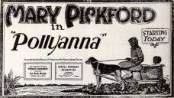
Pollyanna (1920)
https://www.youtube.com/watch?v=4WKLGHRAu-4

Slide 6
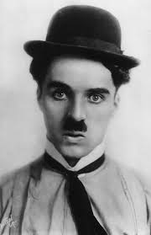
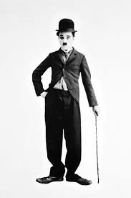
« Silent films » Charlie Chaplin
https://www.youtube.com/watch?v=bMMcTU1b_9o&t=2732s
https://www.youtube.com/watch?v=0daS_SDCT_U

Slide 7
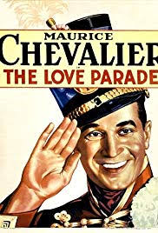
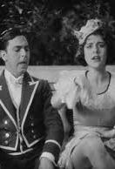
The Love Parade (1929)
https://www.youtube.com/watch?v=FtoyL6l4p6I

